Slide 1
Lesson 3:
Tracing algorithms
Mack 2023
Notes:
Last updated: 6/14/2023

Slide 2
Warm Up

Slide 3

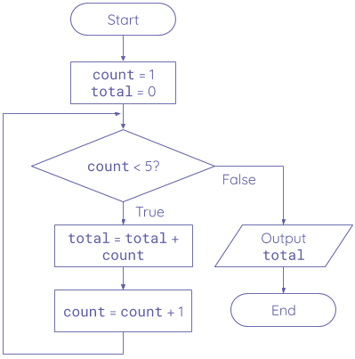
What is the output?
Starter activity
Questions .
What will be output when this flowchart is executed?
4
10
15
There is an error in the flowchart
1
▹
2
3
4

Slide 4
What is the output? Walkthrough
Starter activity
State .
count
1
total
0
Process .
Assign 1 to the variable count
Assign 0 to the variable total
Output .

Slide 5
What is the output? Walkthrough
Starter activity
State .
count
1
total
0
Process .
Check if the condition is True
Output .

Slide 6
What is the output? Walkthrough
Starter activity
State .
count
1
total
1
Process .
Add the value of count to the value held by total
Output .

Slide 7
What is the output? Walkthrough
Starter activity
State .
count
2
total
1
Process .
Add 1 to the value held by count
Output .

Slide 8
What is the output? Walkthrough
Starter activity
State .
count
2
total
1
Process .
Check if the condition is True
Output .

Slide 9
What is the output? Walkthrough
Starter activity
State .
count
2
total
3
Process .
Add the value of count to the value held by total
Output .

Slide 10
What is the output? Walkthrough
Starter activity
State .
count
3
total
3
Process .
Add 1 to the value held by count
Output .

Slide 11
What is the output? Walkthrough
Starter activity
State .
count
3
total
3
Process .
Check if the condition is True
Output .

Slide 12
What is the output? Walkthrough
Starter activity
State .
count
3
total
6
Process .
Add the value of count to the value held by total
Output .

Slide 13
What is the output? Walkthrough
Starter activity
State .
count
4
total
6
Process .
Add 1 to the value held by count
Output .

Slide 14
What is the output? Walkthrough
Starter activity
State .
count
4
total
6
Process .
Check if the condition is True
Output .

Slide 15
What is the output? Walkthrough
Starter activity
State .
count
4
total
10
Process .
Add the value of count to the value held by total
Output .

Slide 16
What is the output? Walkthrough
Starter activity
State .
count
5
total
10
Process .
Add 1 to the value held by count
Output .

Slide 17
What is the output? Walkthrough
Starter activity
State .
count
5
total
10
Process .
Check if the condition is True
Output .

Slide 18
What is the output? Walkthrough
Starter activity
State .
count
5
total
10
Process .
The loop terminates and the instruction from the False branch is executed
Output .
10

Slide 19

Lesson 45: Tracing algorithms
Objectives
In this lesson, you will:
Use a trace table to walk through code that contains a while loop, a for loop and a list of items
Use a trace table to detect and correct errors in a program

Slide 20
Activity 1

Slide 21

Using a trace table
Activity 1
Walking through an algorithm and checking the state of the variables is a useful tool for understanding how the algorithm works.
It is also great for detecting and correcting errors.
To help us with this you can use a trace table.
count | total | Condition | Output
1
 | 0
 |  | True
 | 1
2
 |  | True
 | 3
3
 |  | True
 | 6
4
 |  | True
 | 10
5
 |  | False
 |  |  | 10

Slide 22
Using a trace table
Activity 1
A trace table allows you to formally record the state of variables, the outputs and the condition evaluations as you mentally execute the algorithm.
count | total | Condition | Output
1
 | 0
 |  | True
 | 1
2
 |  | True
 | 3
3
 |  | True
 | 6
4
 |  | True
 | 10
5
 |  | False
 |  |  | 10

Slide 23
Trace table example
Activity 1
1 2 3 4 5 6 | print("Enter a number:") num = int(input()) while num > 2: if num % 3 == 0: print(num) num = num - 1
A learner has written a Python program that should output all the numbers between 0 and the input value which are divisible by 3.
You want to test that the code executes without any logic errors.
Here is how a trace table can help you check the program.

Slide 24
Trace table example
Activity 1
1 2 3 4 5 6 | print("Enter a number:") num = int(input()) while num > 2: if num % 3 == 0: print(num) num = num - 1
Line | Variable? | Condition | Output
Here is a blank trace table.

Slide 25
Trace table example
Activity 1
1 2 3 4 5 6 | print("Enter a number:") num = int(input()) while num > 2: if num % 3 == 0: print(num) num = num - 1
Line | num | Condition | Output
We can identify the variables and conditions and add them to the headings to help keep track of the algorithm.

Slide 26
Trace table example
Activity 1
1 2 3 4 5 6 | print("Enter a number:") num = int(input()) while num > 2: if num % 3 == 0: print(num) num = num - 1
Line | num | Condition | Output
Then walk through the code. The first line has no variables, conditions or output so we don’t add anything to the table.

Slide 27
Trace table example
Activity 1
1 2 3 4 5 6 | print("Enter a number:") num = int(input()) while num > 2: if num % 3 == 0: print(num) num = num - 1
Line | num | Condition | Output
2 | 6
On line 2, the program asks the user for a value. We will choose the value 6 which is then assigned to the num variable, so we record this on the table.

Slide 28
Trace table example
Activity 1
1 2 3 4 5 6 | print("Enter a number:") num = int(input()) while num > 2: if num % 3 == 0: print(num) num = num - 1
Line | num | Condition | Output
2 | 6
3 |  | True
Line 3 has a condition, num > 2. The condition is evaluated and we record the value on the table.

Slide 29
Trace table example
Activity 1
1 2 3 4 5 6 | print("Enter a number:") num = int(input()) while num > 2: if num % 3 == 0: print(num) num = num - 1
Line | num | Condition | Output
2 | 6
3 |  | True
4 |  | True
Line 4 has a condition, num % 3 == 0. This uses the modulo (MOD) to calculate the remainder of num divided by 3.
In this case, 6 MOD 3 will calculate as 0 so the condition evaluates to True.

Slide 30
Trace table example
Activity 1
1 2 3 4 5 6 | print("Enter a number:") num = int(input()) while num > 2: if num % 3 == 0: print(num) num = num - 1
Line | num | Condition | Output
2 | 6
3 |  | True
4 |  | True
5 |  |  | 6
As the condition for line 4 was True, we step into the if statement.
Line 5 produces an output so we record it on the table.

Slide 31
Trace table example
Activity 1
1 2 3 4 5 6 | print("Enter a number:") num = int(input()) while num > 2: if num % 3 == 0: print(num) num = num - 1
Line | num | Condition | Output
2 | 6
3 |  | True
4 |  | True
5 |  |  | 6
6 | 5
Line 6 has a variable assignment. The expression num - 1 retrieves the current value of num and reduces it by 1. This new value then replaces the value of num.

Slide 32
Trace table example
Activity 1
1 2 3 4 5 6 | print("Enter a number:") num = int(input()) while num > 2: if num % 3 == 0: print(num) num = num - 1
Line | num | Condition | Output
2 | 6
3 |  | True
4 |  | True
5 |  |  | 6
6 | 5
3 |  | True
As we have reached the end of the while block, we go back and check the condition again.
Line 3’s condition is still True so we record this.

Slide 33
Trace table example
Activity 1
1 2 3 4 5 6 | print("Enter a number:") num = int(input()) while num > 2: if num % 3 == 0: print(num) num = num - 1
Line | num | Condition | Output
2 | 6
3 |  | True
4 |  | True
5 |  |  | 6
6 | 5
3 |  | True
4 |  | False
Line 4 uses modulo (MOD) to calculate the remainder of num divided by 3.
In this case, 5 MOD 3 will calculate as 2 so the condition evaluates to False.

Slide 34
Trace table example
Activity 1
1 2 3 4 5 6 | print("Enter a number:") num = int(input()) while num > 2: if num % 3 == 0: print(num) num = num - 1
Line | num | Condition | Output
2 | 6
3 |  | True
4 |  | True
5 |  |  | 6
6 | 5
3 |  | True
4 |  | False
6 | 4
As the condition for line 4 was False, we move on to line 6.
Line 6 has a variable assignment so we record this.

Slide 35
Trace table example
Activity 1
1 2 3 4 5 6 | print("Enter a number:") num = int(input()) while num > 2: if num % 3 == 0: print(num) num = num - 1
Line | num | Condition | Output
2 | 6
3 |  | True
4 |  | True
5 |  |  | 6
6 | 5
3 |  | True
4 |  | False
6 | 4
3 |  | True
As we have reached the end of the while block, we go back and check the condition again.
Line 3’s condition is still True so we record this.

Slide 36
Trace table example
Activity 1
1 2 3 4 5 6 | print("Enter a number:") num = int(input()) while num > 2: if num % 3 == 0: print(num) num = num - 1
Line | num | Condition | Output
2 | 6
3 |  | True
4 |  | True
5 |  |  | 6
6 | 5
3 |  | True
4 |  | False
6 | 4
3 |  | True
Question .
What will the condition on line 4 evaluate to?

Slide 37
Trace table example
Activity 1
1 2 3 4 5 6 | print("Enter a number:") num = int(input()) while num > 2: if num % 3 == 0: print(num) num = num - 1
Line | num | Condition | Output
2 | 6
3 |  | True
4 |  | True
5 |  |  | 6
6 | 5
3 |  | True
4 |  | False
6 | 4
3 |  | True
4 |  | False
In this case, 4 MOD 3 will calculate as 1 so the condition evaluates to False.

Slide 38
Trace table example
Activity 1
1 2 3 4 5 6 | print("Enter a number:") num = int(input()) while num > 2: if num % 3 == 0: print(num) num = num - 1
Line | num | Condition | Output
2 | 6
3 |  | True
4 |  | True
5 |  |  | 6
6 | 5
3 |  | True
4 |  | False
6 | 4
3 |  | True
4 |  | False
6 | 3
As the condition for line 4 was False, we move on to line 6.
Line 6 has a variable assignment so we record this.

Slide 39
Trace table example
Activity 1
1 2 3 4 5 6 | print("Enter a number:") num = int(input()) while num > 2: if num % 3 == 0: print(num) num = num - 1
Line | num | Condition | Output
2 | 6
3 |  | True
4 |  | True
5 |  |  | 6
6 | 5
3 |  | True
4 |  | False
6 | 4
3 |  | True
4 |  | False
6 | 3
3 |  | True
As we have reached the end of the while block, we go back and check the condition again.
Line 3’s condition is still True so we record this.

Slide 40
Trace table example
Activity 1
1 2 3 4 5 6 | print("Enter a number:") num = int(input()) while num > 2: if num % 3 == 0: print(num) num = num - 1
Line | num | Condition | Output
2 | 6
3 |  | True
4 |  | True
5 |  |  | 6
6 | 5
3 |  | True
4 |  | False
6 | 4
3 |  | True
4 |  | False
6 | 3
3 |  | True
4 |  | True
In this case, 3 MOD 3 will calculate as 0 so the condition evaluates to True.

Slide 41
Trace table example
Activity 1
1 2 3 4 5 6 | print("Enter a number:") num = int(input()) while num > 2: if num % 3 == 0: print(num) num = num - 1
Line | num | Condition | Output
2 | 6
3 |  | True
4 |  | True
5 |  |  | 6
6 | 5
3 |  | True
4 |  | False
6 | 4
3 |  | True
4 |  | False
6 | 3
3 |  | True
4 |  | True
5 |  |  | 3
As the condition for line 4 was True, we step into the if statement.
Line 5 produces an output so we record it on the table.

Slide 42
Trace table example
Activity 1
1 2 3 4 5 6 | print("Enter a number:") num = int(input()) while num > 2: if num % 3 == 0: print(num) num = num - 1
Line | num | Condition | Output
2 | 6
3 |  | True
4 |  | True
5 |  |  | 6
6 | 5
3 |  | True
4 |  | False
6 | 4
3 |  | True
4 |  | False
6 | 3
3 |  | True
4 |  | True
5 |  |  | 3
6 | 2
Line 6 has a variable assignment so we record this.

Slide 43
Trace table example
Activity 1
1 2 3 4 5 6 | print("Enter a number:") num = int(input()) while num > 2: if num % 3 == 0: print(num) num = num - 1
Line | num | Condition | Output
2 | 6
3 |  | True
4 |  | True
5 |  |  | 6
6 | 5
3 |  | True
4 |  | False
6 | 4
3 |  | True
4 |  | False
6 | 3
3 |  | True
4 |  | True
5 |  |  | 3
6 | 2
3 |  | False
Line 3’s condition is now False so we record this.
As there are no more lines of code after the while block, the program will now end.

Slide 44
Trace table example
Activity 1
1 2 3 4 5 6 | print("Enter a number:") num = int(input()) while num > 2: if num % 3 == 0: print(num) num = num - 1
Line | num | Condition | Output
2 | 6
3 |  | True
4 |  | True
5 |  |  | 6
6 | 5
3 |  | True
4 |  | False
6 | 4
3 |  | True
4 |  | False
6 | 3
3 |  | True
4 |  | True
5 |  |  | 3
6 | 2
3 |  | False
The trace table has shown us that the program does only output numbers divisible by 3 based on the given input.
If there had been a logic error, it would have been easy to spot exactly where the problem was when executing the code.

Slide 45
Activity 2

Slide 46
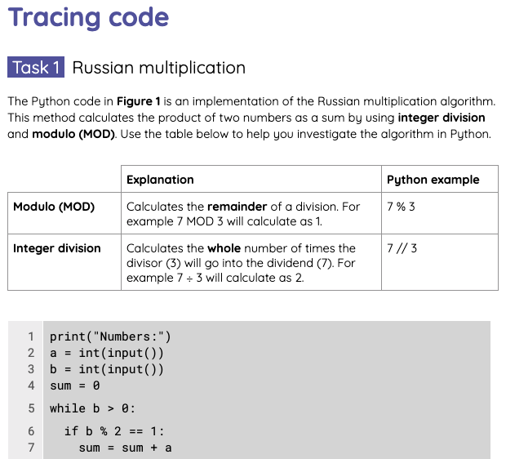
Tracing code
Activity 2
Use the Activity 2 worksheet to complete a series of trace tables for different scenarios.

Slide 47
Wrap Up

Slide 48

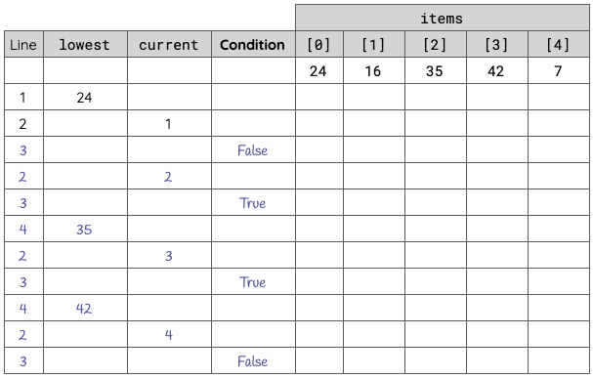
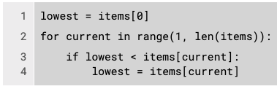
Tracing code - Solution
Wrap Up
Peer- or self-assess the tasks you completed using the Activity 2 solution sheet.

Slide 49
Next lesson
Summary
In this lesson, you…
Used a trace table to walk through code that contains a while loop, a for loop and a list of items.
Used a trace table to detect and correct errors in a program.
Next lesson, you will…
Investigate a searching algorithm called linear search.

